Slide 1



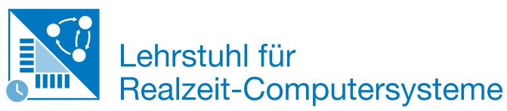
Mapping Artificial Neural Network Operations for Inference on
Coral Edge TPU
Bachelor’s Thesis
Supervisor:
M.Sc. Alex Hoffman
Advising Professor:
Prof. Dr. Daniel Müller-Gritschneder
Student:
Ala Fnayou
ge69faf
03697266
Notes:
‹#›

Slide 2
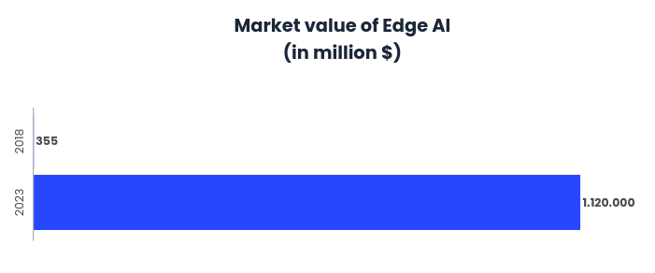
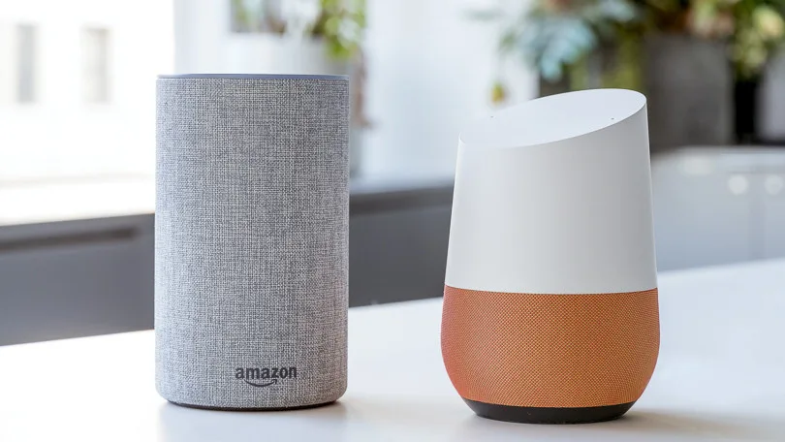
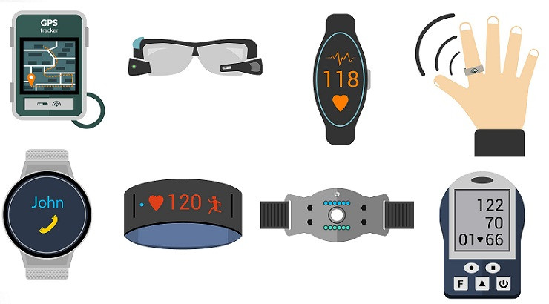
Motivation: Edge AI
Edge Computing
Artificial Intelligence
Edge AI
Edge AI systems
Process data gathered by hardware devices locally
Eliminate privacy and security issues related to data transfer
Reduce network latency times for an improved user experience
⇒ Emergence of a new breed of revolutionary products
Improvement of Market value of Edge AI between 2018 and 2023 [1]
Amazon’s Alexa and Google Home [2]
Set of futuristic wearable products [3]
A. Fnayou
Notes:
The marriage of Edge computing representing computation at the edge of the Network and Artificial Intelligence has resulted in a futuristic field called Edge AI
Edge AI defines the ability of Edge devices to harness AI capabilities to do a variety of tasks
Such systems tend to process the data that is usually gathered by edge and IoT devices locally
This eliminates privacy and security issues related to data transfer as well as reduces network latency and waiting times
On another hand, the market of Edge AI is exponentially growing and estimated to reach 1 trillion dollars by 2023
Edge AI systems are already emerging, a couple of examples would be Amazon’s Alexa and Google Home. Further development in the field can lead to wearable products, smarter watches and futuristic gadgets
‹#›

Slide 3
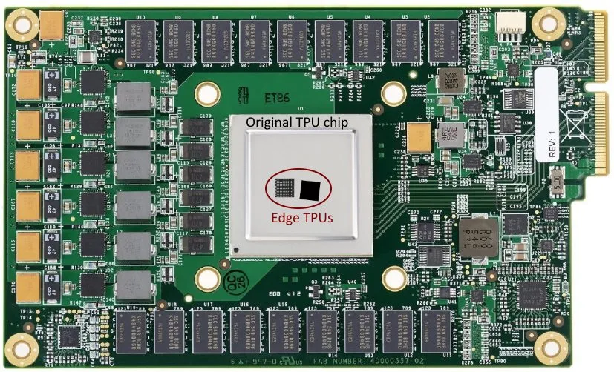
Motivation: Tiny Machine Learning
Tiny ML represents the new trend of running ML algorithms on memory and power constrained platforms.
Requires the design of new optimization techniques aimed at the hardware and software level.
Hardware
Google’s Coral Edge TPU
Software
Distributed Machine Learning based on the Design Space Exploration methodology
Comparison between TPU and Edge TPU chips [4]
A. Fnayou
Notes:
A new trend called Tiny Machine Learning is rapidly evolving with the aim of equipping power and memory constrained platforms with the possibility to run ML models
Optimization techniques focused at the hardware and software are crucial
For instance, Google launched its high-performance AI Acceleration chip called the TPU
The TPU was initially used in Google’s datacenters
A much smaller version of the TPU called the Edge TPU was designed enabling the acceleration of ML workloads at the Edge
The figure illustrates the difference in dimensions between the initial TPU and the Edge TPU
This furhter confirms the importance of Edge AI
An example that highlights software optimization techniques would be distributed ML using DSE methodology
‹#›

Slide 4
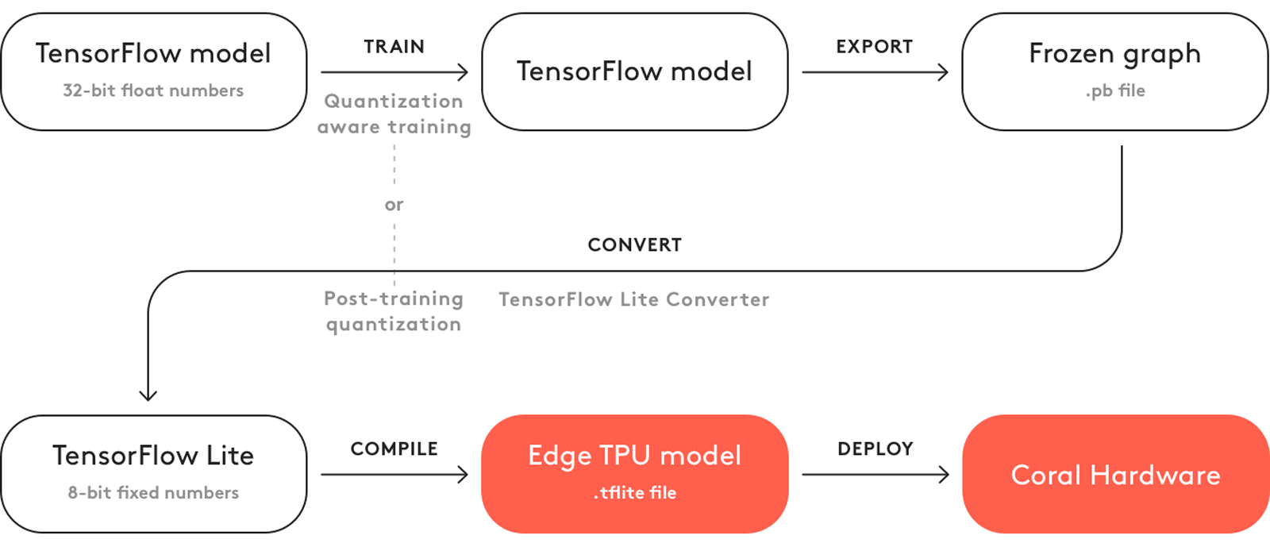
Background: TensorFlow Models on the Edge TPU
Design Space Exploration analysis generates an operation-mapping that distributes the inference of a ML model on heteregeneous hardware devices including Google’s Coral Edge TPU USB Accelerator
Running models on the Edge TPU requires
Tensor parameters to be quantized (8-bit fixed-point numbers; int8 or uint8)
The model to use only the operations supported by the Edge TPU
Workflow of deploying TF models on the Edge TPU [5]
A. Fnayou
Notes:
The DSE generates a mapping of operations able to distribute the inference of ML models across multiple hardware devices including the Edge TPU in a very efficient manner
It is possible to deploy TensorFlow models on the Coral Edge TPU once a set of requirements is fulfilled
Most importantly
Full integer quantization of the model’s parameters
The model needs to be compiled specifically for the Edge TPU
The full workflow needed to deploy a TensorFlow model on the Edge TPU is as follows
‹#›

Slide 5
Background: TensorFlow Lite and FlatBuffers
TensorFlow Lite models are saved using an optimized file extension based on FlatBuffers, namely .tflite
Using the schema.fbs file provided by TensorFlow and the FlatBuffers schema compiler it is possible to
Generate Python helper classes to access and construct serialized data in the model
Convert the model from binary to JSON
A TF Lite model can be represented as
a read-only binary saved in the .tflite file extension
a read/write JSON saved in the .json file extension
⇒ TensorFlow Lite models can be freely modified once converted to JSON
A. Fnayou
Notes:
‹#›

Slide 6
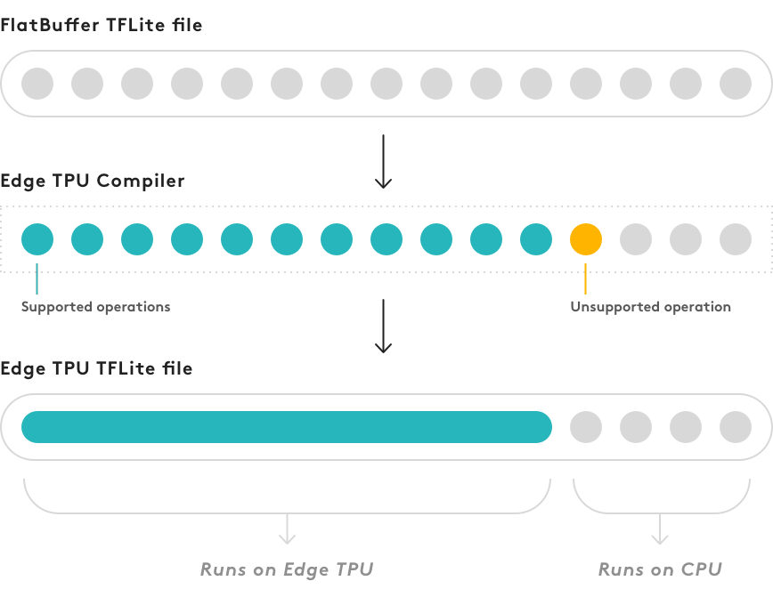
Problem Statement
The Edge TPU Compiler
analyses the operations present in the model
stops When an unsupported operations is encountered
⇒ Only one portion of the model can be mapped to the Edge TPU
The Edge TPU Compiler is closed-source software
⇒ Impossible to change internal behavior
A. Fnayou
Behavior of the Edge TPU Compiler [6]
Notes:
‹#›

Slide 7
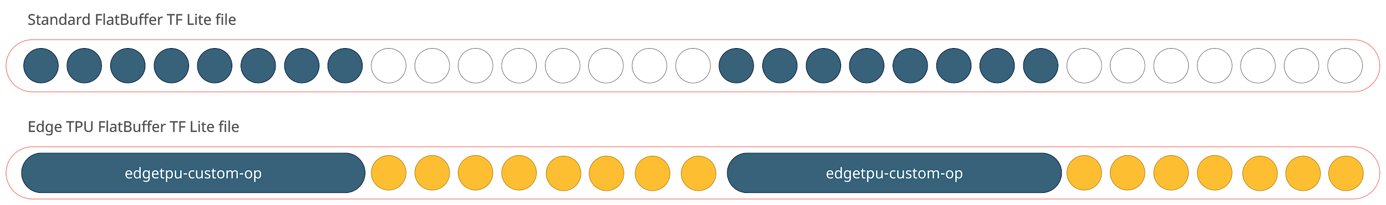
Problem Statement: Desired Behavior
The described behavior makes the execution of an efficient operation-mapping generated by the DSE analysis impossible to realize
The proposed solution succeeds at overcoming this challenge
⇒ Allows mapping of any operation either to the Edge TPU or to the CPU
A. Fnayou
Notes:
‹#›

Slide 8
Related Work: Software Level Approaches
Virtualizing AI at the Distributed Edge [7]
Based on the IoT virtualization concept
Design of a virtualization layer responsible for the semantic description of AI-embedded IoT devices
⇒ Relieving the pressure on constrained devices
⇒ Targeting interoperability among AI-powered platforms.
ADaptive Synchronous Parallel [8]
a parameter synchronization model
⇒ Decreasing waiting time to a minimum while maintaining an optimized usage of computational resources.
A. Fnayou
Notes:
Virtualization is the logical abstraction of the underlying hardware devices within a network, through software implementation. The abstraction decouples the control from hardware, and makes it easier to modify, manage, and upgrade.
A parameter synchronization model specifies when each worker commits its gradients to the PS and whether it should be synchronized with updates from other workers; it critically affects convergence speed of model training. Three representative synchronization models, BSP, SSP and TAP, have been compared in (Hsieh et al. 2017), which proves that BSP and SSP guarantee model convergence whereas TAP does not.
‹#›

Slide 9
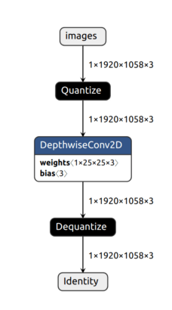
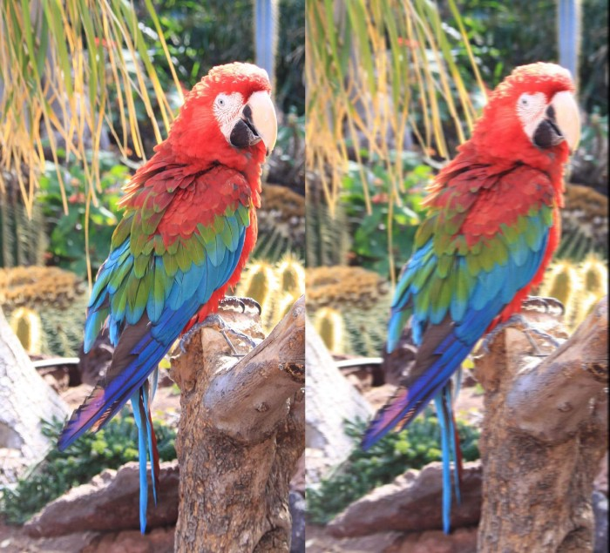
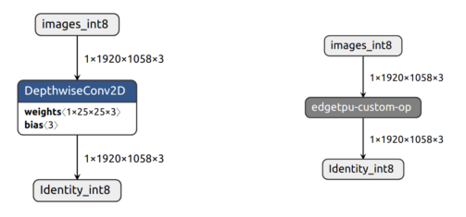
Related Work: Upgrading a TF Lite model
Upgrading a TF Lite model to run Motion Blur on the Coral Edge TPU
Converts TF Lite model to JSON
Removes unsupported operations
Changes Tensor data types
A. Fnayou
MotionBlur effect [9]
Model used to achieve MotionBlur visualized using Netron [9]
Notes:
Virtualization is the logical abstraction of the underlying hardware devices within a network, through software implementation. The abstraction decouples the control from hardware, and makes it easier to modify, manage, and upgrade.
A parameter synchronization model specifies when each worker commits its gradients to the PS and whether it should be synchronized with updates from other workers; it critically affects convergence speed of model training. Three representative synchronization models, BSP, SSP and TAP, have been compared in (Hsieh et al. 2017), which proves that BSP and SSP guarantee model convergence whereas TAP does not.
‹#›

Slide 10
Goal and Approach
Goal of the thesis
Map any operation present in a TF Lite model freely either to the Edge TPU or to the CPU.
Approach
Use the JSON representation to modify the TF Lite model
Separate the operations mapped to the Edge TPU and save them into separate files
Compile the submodels separately using the edgetpu-compiler
Re-assemble the model to contain operations with different mapping targets
A. Fnayou
Notes:
‹#›

Slide 11
Implementation: TF Lite model in JSON
Structure of a JSON file representing TF Lite model
Structure of the "subgraphs" element
{
"version": 3,
"operator_codes": [
{
"deprecated_builtin_code": 3,
"version": 1,
"builtin_code": "ADD"
}
],
"subgraphs": [
],
"description": "TOCO Converted.",
"buffers": [
],
"metadata": [
{
"name": "min_runtime_version",
"buffer": 0
}
]
}
"subgraphs": [
{
"tensors": [
],
"inputs": [
],
"outputs": [
],
"operators": [
{
"opcode_index": 0,
"inputs": [
],
"outputs": [
],
"builtin_options_type":,
"builtin_options": {
},
"custom_options_format":,
"mutating_variable_inputs": []
}
]
}
]
A. Fnayou
Notes:
‹#›

Slide 12
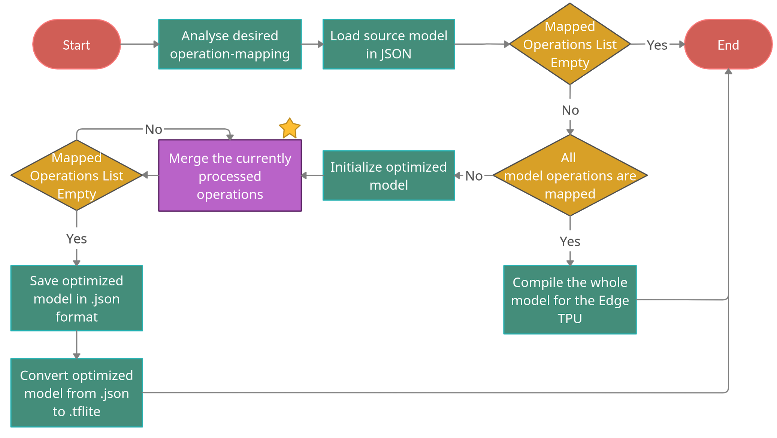
Implementation: Algorithm Flow Chart
A. Fnayou
Notes:
‹#›

Slide 13
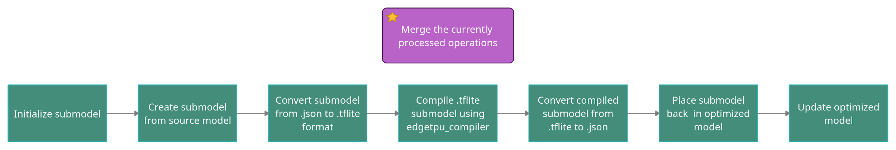
Implementation: Merging Operations
A. Fnayou
Notes:
‹#›

Slide 14
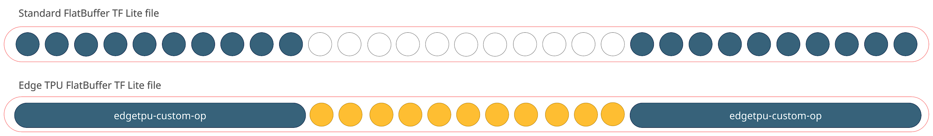
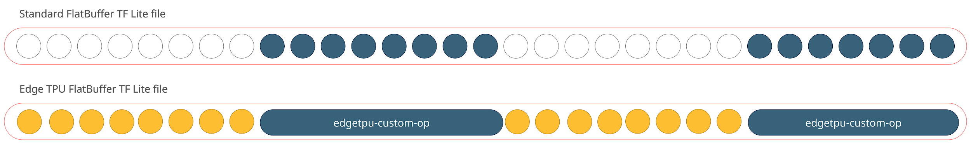
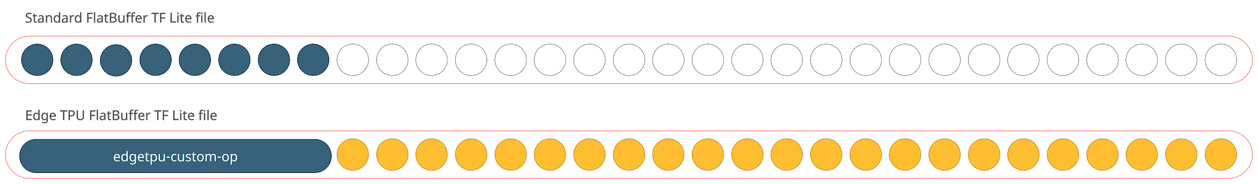
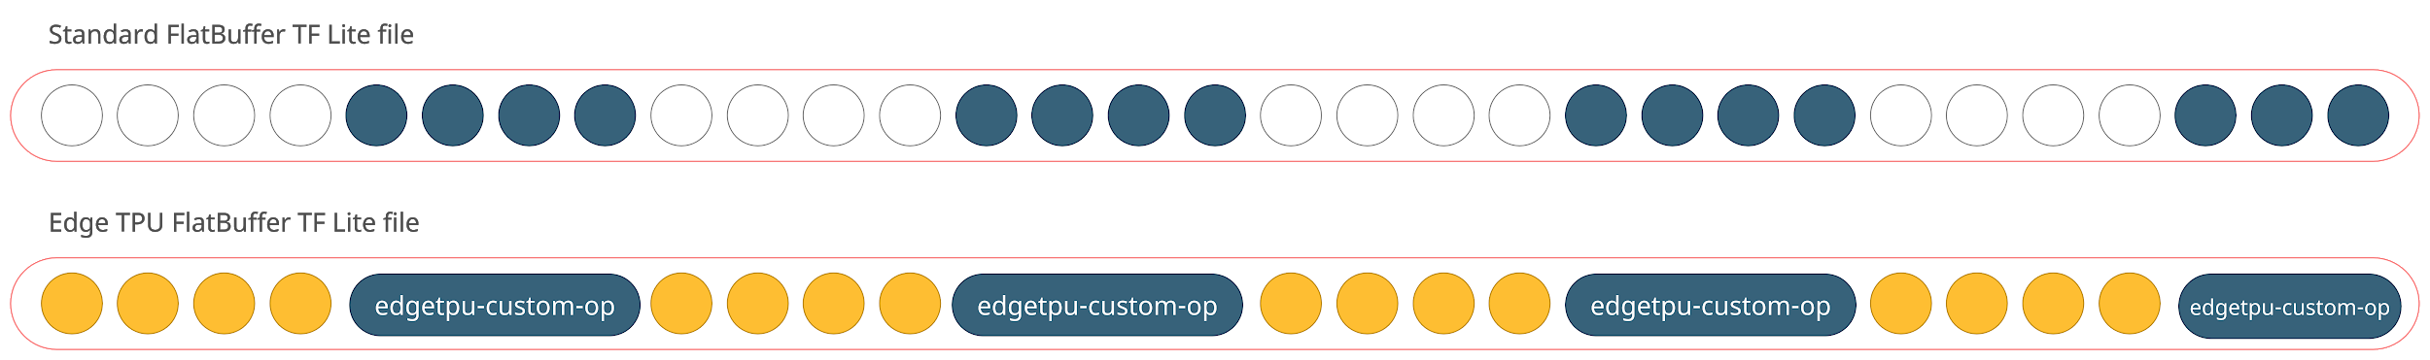
Experimental Setup
A series of experiments was conducted involving
Creation of multiple optimized models, each representing a mapping scenario
Benchmarking each model
Gathering Python inference times
The mapping scenarios aim at highlighting the effect of varying some parameters on the inference time
Number of edgetpu-custom-ops in the model
Total number of operations mapped to the Edge TPU
The target hardware on which the model starts its execution
A. Fnayou
Notes:
‹#›

Slide 15
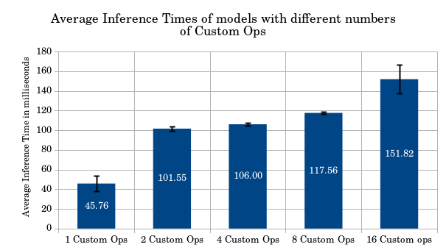
Results: Varying the number of edgetpu-custom-ops
N° of Custom Ops | Increase in %
1 Custom Ops
2 Custom Ops | 55%
3 Custom Ops | 4%
4 Custom Ops | 10%
5 Custom Ops | 23%
⇒ Increasing the number of Custom Ops while maintaining the same number of operations mapped to the Edge TPU results in an increase in inference times
A. Fnayou
Notes:
‹#›

Slide 16
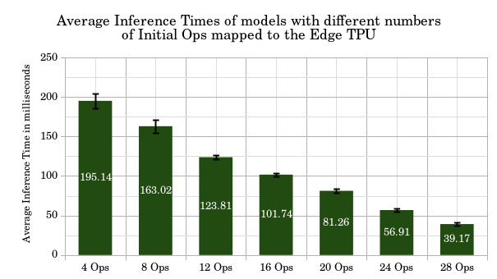
Results: Varying the total number of Initial operations mapped to the Edge TPU
N° of Ops mapped to the Edge TPU | Decrease in %
4 Ops
8 Ops | 16%
12 Ops | 24%
16 Ops | 18%
20 Ops | 20%
24 Ops | 30%
28 Ops | 32%
⇒ Increasing the total number of Ops mapped to the Edge TPU results in a decrease in inference times
A. Fnayou
Notes:
‹#›

Slide 17
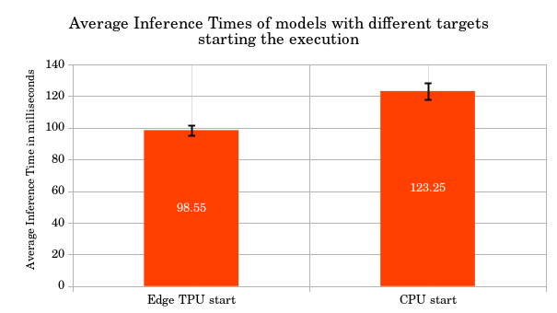
Results: Varying the target hardware on which the model starts its execution
⇒ Starting execution on the CPU results in a 20% increase in inference times
A. Fnayou
Notes:
‹#›

Slide 18
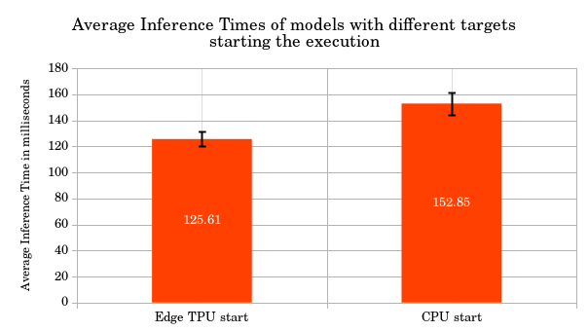
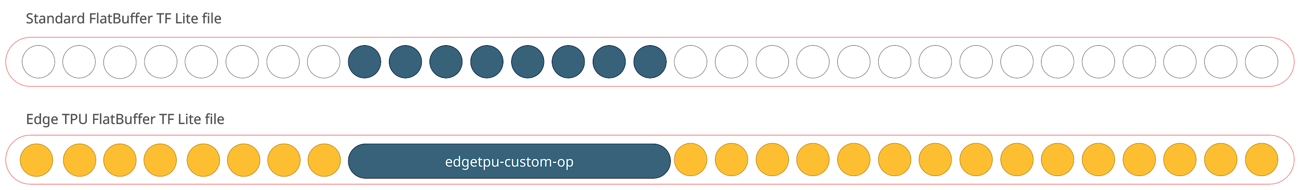
Results: Varying the target hardware on which the model starts its execution
⇒ Starting execution on the CPU results in a 18% increase in inference times
A. Fnayou
Notes:
‹#›

Slide 19
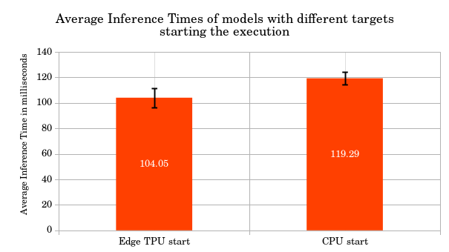
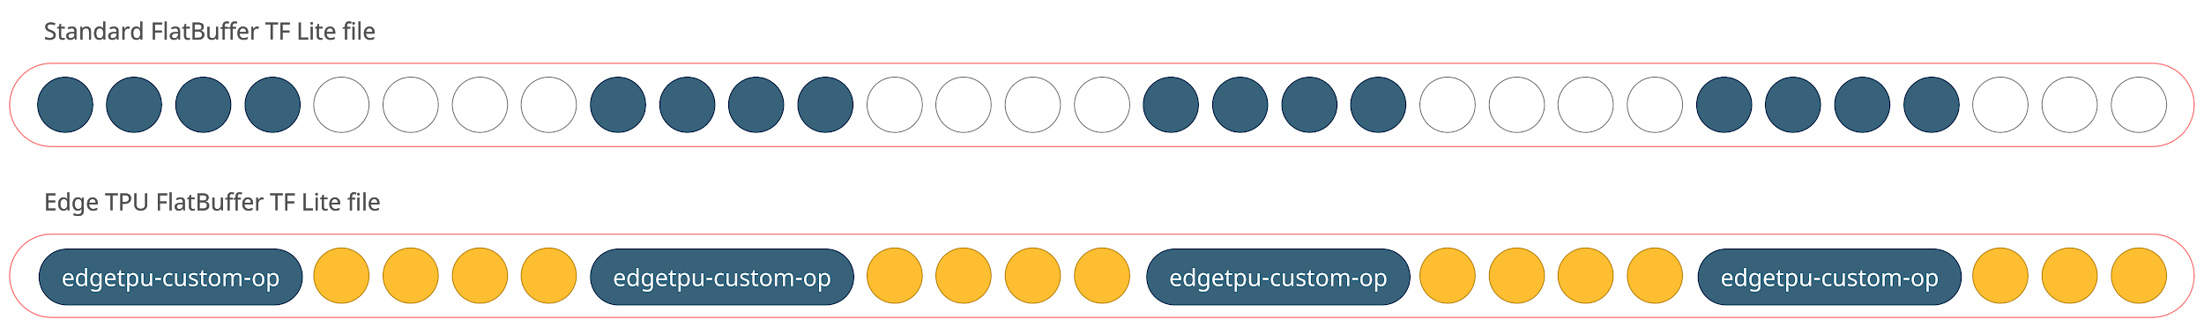
Results: Varying the target hardware on which the model starts its execution
⇒ Starting execution on the CPU results in a 15% increase in inference times
A. Fnayou
Notes:
‹#›

Slide 20
Conclusions and Future Work
Conclusions
TF Lite models can be freely modified and upgraded once converted to JSON
Any combination of operations present in a TF Lite model can be freely mapped to either the Edge TPU or a
general-purpose CPU
Future Work
Support bigger and more complex models
Support more hardware targets like GPUs and potentially, embedded-edge devices
A. Fnayou
Notes:
‹#›

Slide 21
Bibliography
[1] Vector ITC, Edge AI: The Future of Artificial Intelligence, [Online]. Available: https://www.vectoritcgroup.com/en/tech-magazine-en/artificial-intelligence-en/edge-ai-el-futuro-de-la-inteligencia-artificial/
[2] [Online]. Available: https://uk.pcmag.com/speakers/85210/amazon-echo-vs-google-home-which-voice-controlled-
speaker-is-right-for-you
[3] [Online]. Available: https://www.sportswearable.net/global-smart-wearables-and-sports-clothings-market-2019/
[4] [Online]. Available: https://qengineering.eu/google-corals-tpu-explained.html
[5] Coral-Team. Tensorflow models on the edge tpu. [Online]. Available: https://coral.ai/docs/edgetpu/models-intro/#compatibility-overview
[6] Coral-Team. Tensorflow models on the edge tpu. [Online]. Available: https://coral.ai/docs/edgetpu/models-intro/#compiling
[7] C. Campolo, G. Genovese, A. Iera, and A. Molinaro, “Virtualizing ai at the distributed edge towards intelligent iot applications,” Journal of Sensor and Actuator Networks, vol. 10, no. 1, 2021. [Online]. Available: https://www.mdpi.com/2224-2708/10/1/13
[8] H. Hu, D. Wang, and C. Wu, “Distributed machine learning through heterogeneous edge systems,” Proceedings of the AAAI Conference on Artificial Intelligence, vol. 34, no. 05, pp. 7179–7186, Apr. 2020. [Online]. Available: https://ojs.aaai.org/index.php/AAAI/ article/view/6207
[9] V. Markovtsev. Hacking google coral edge tpu: motion blur and lanczos resize. [Online]. Available: https://towardsdatascience.com/ hacking-google-coral-edge-tpu-motion-blur-and-lanczos-resize-9b60ebfaa552
A. Fnayou
Notes:
‹#›

Slide 22
Benchmarking Inference on Google’s Coral Edge TPU
Research Internship
Supervisor:
M.Sc. Alex Hoffman
Advising Professor:
Prof. Dr. Daniel Müller-Gritschneder
Student:
Daniel Duclos-Cavalcanti
ga74ped
03692475
Notes:
‹#›

Slide 23
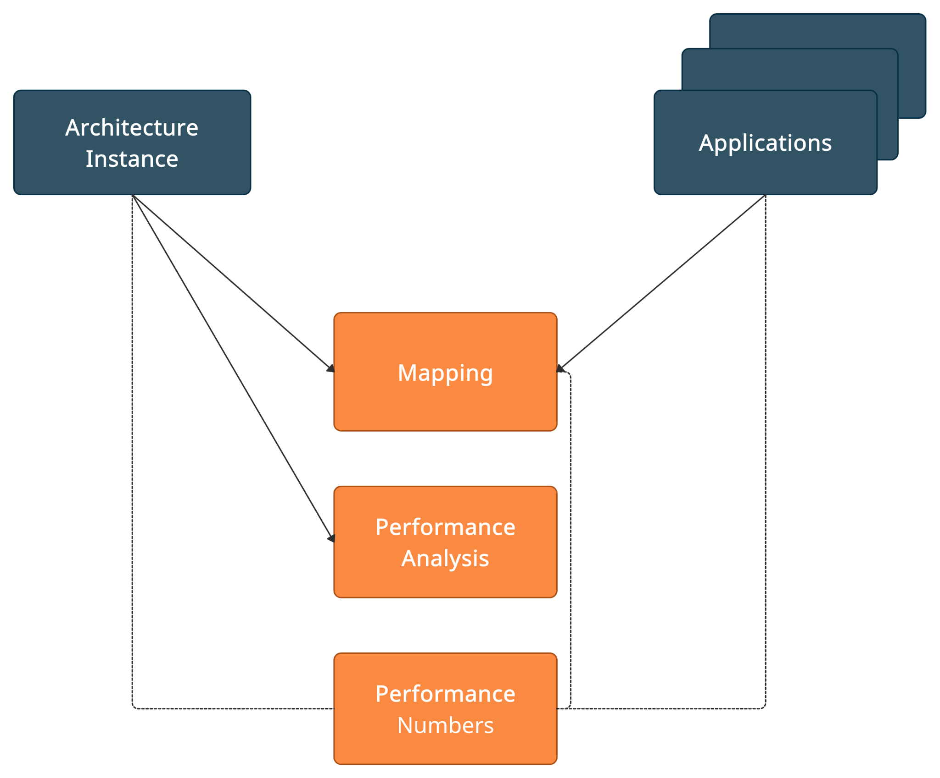
Introduction - Design Space Exploration
DSE:
Optimal mapping to distribute inference of a ML model.
Done across heterogeneous hardware devices.
D. Duclos-Cavalcanti
Notes:
‹#›

Slide 24
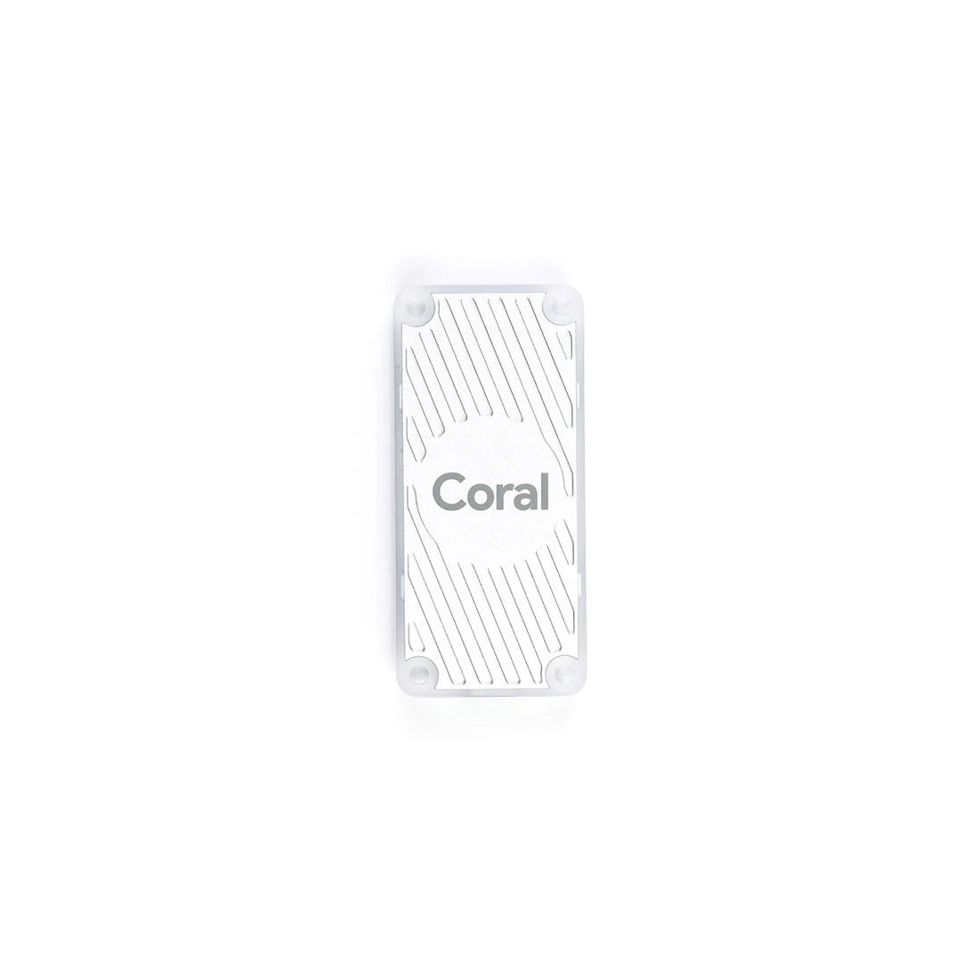
Motivation
Motivation:
More granular or precise inference measurements, benchmark Google’s Coral Edge.
Problem Statement:
Google’s Coral Edge USB Accelerator internal workings are closed source.
An analysis of the USB traffic occuring during inference is needed to obtain more precise results.
D. Duclos-Cavalcanti
Notes:
‹#›

Slide 25
Background - Single Operation Splitting
Splitting
input
Quantization + Conversion + Compilation
Flatbuffers
Schema - Python Classes
Single Layers
input
Conv2D
output
Conv2D
Quantize
MaxPool2D
Reshape
Convert .tflite
FullyConnected
FullyConnected
Relu
Compile through the Edge TPU Compiler
Softmax
Conv2D_edgetpu.tflite
output
MNIST Model
D. Duclos-Cavalcanti
Notes:
‹#›

Slide 26
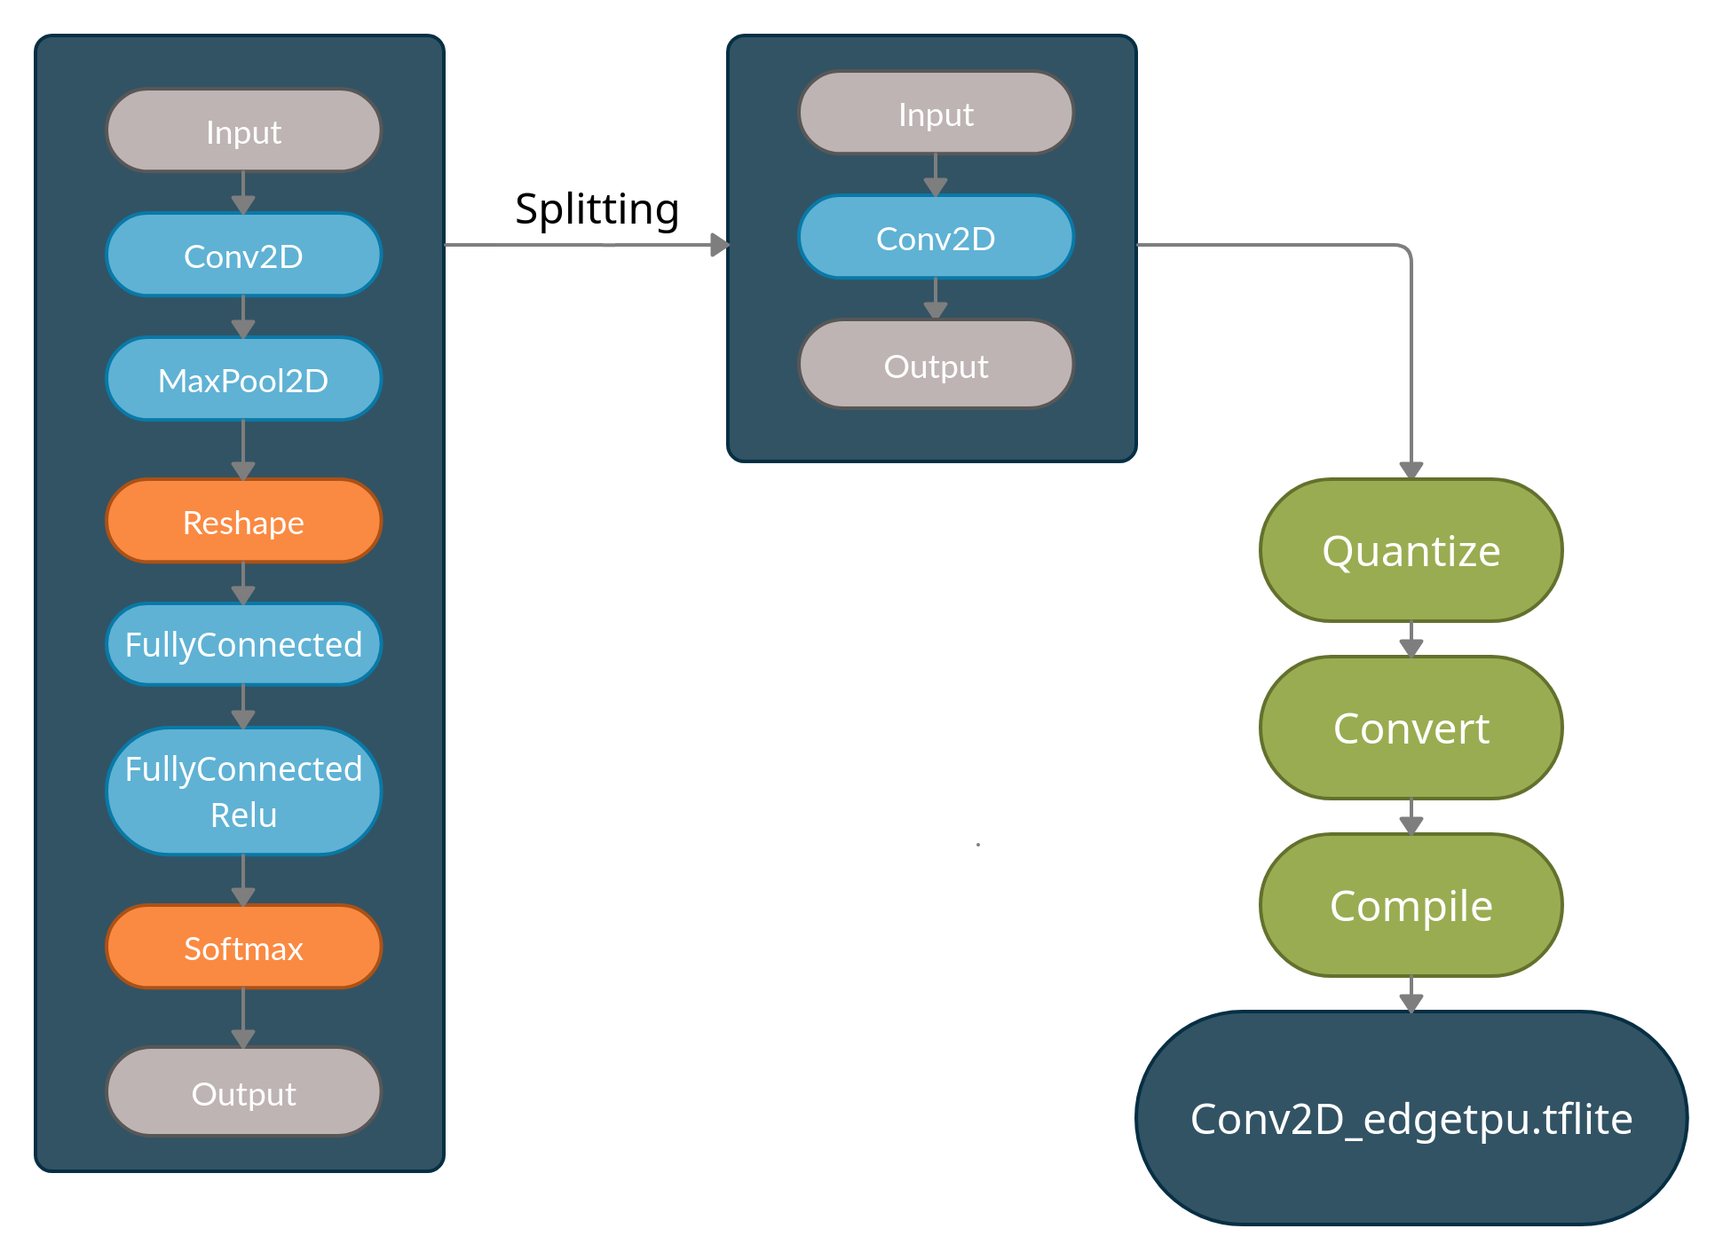
Background - Single Operation Splitting
Split into Single Layers
Flatbuffers
Schema - Python Classes
MNIST Model
D. Duclos-Cavalcanti
Notes:
‹#›

Slide 27
Background - USB Protocol
EP0 In
Function
HOST
Bus
Addr = 1
EP0 Out
Addr
EP1 In
EP1 Out
USB Function
Host-Centric
USB Devices = USB Functions
Endpoints
URB Transfer Types:
Interrupt
Isochronous
Control
Bulk
USB Function
EP0 In
Function
Addr = 2
EP0 Out
EP1 In
EP1 Out
D. Duclos-Cavalcanti
Notes:
‹#›

Slide 28
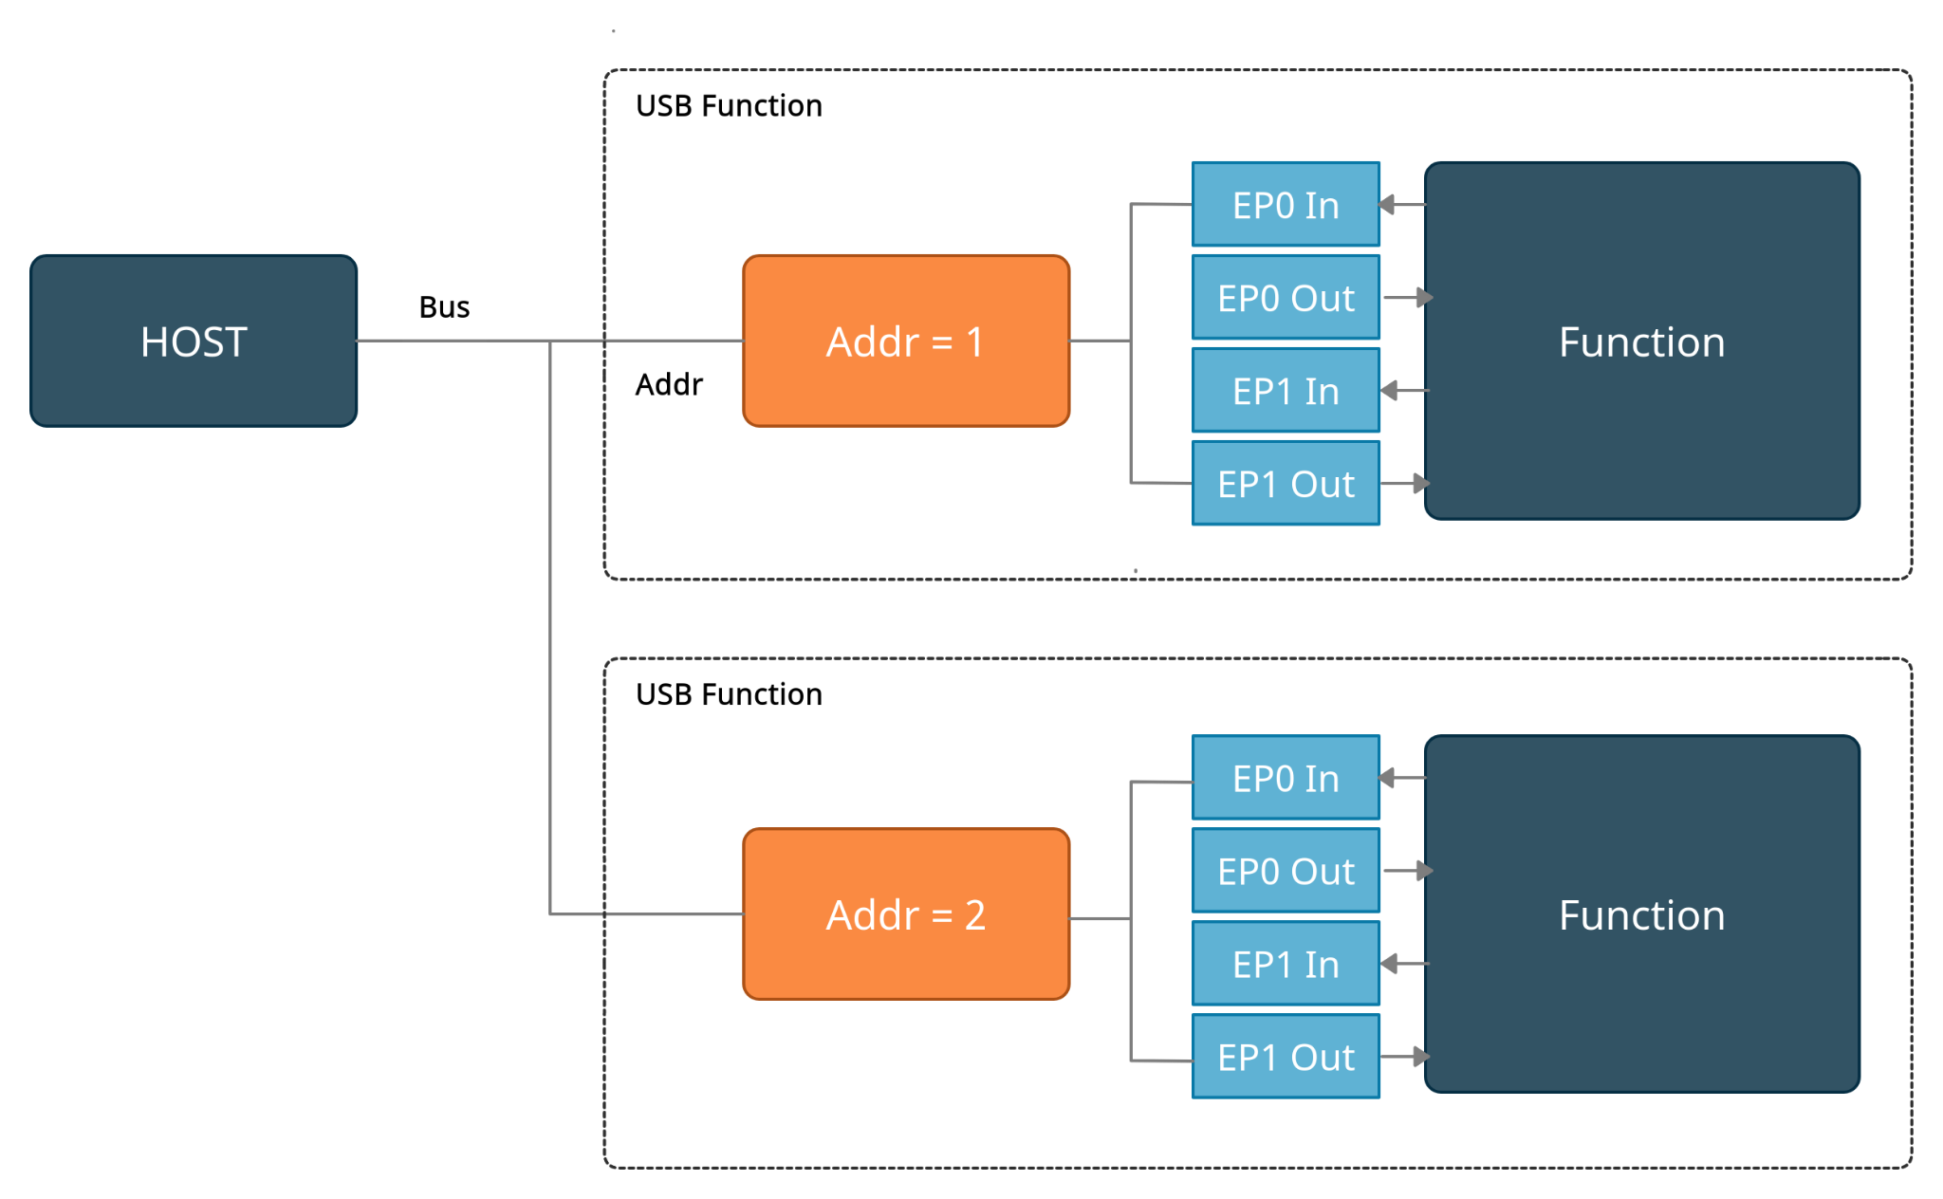
Background - USB Protocol
USB Devices = USB Functions
Endpoints
URB Transfer Types:
Interrupt
Isochronous
Control
Bulk
D. Duclos-Cavalcanti
Notes:
‹#›

Slide 29
Background - USB Transactions
URB Control
Wireshark - captures USB traffic
Main Communication Sections:
Initialization
Host-Data Transfer
TPU Acknowledgement
TPU-Data Transfer
URB Interrupt
URB Bulk In
Initialization
Phase
URB Bulk In
URB Bulk In
Host
Data Transfer
URB Bulk Out
URB Bulk Out
URB Bulk Out
TPU
Acknowledgement
URB Bulk Out
TPU
Data Transfer
URB Bulk In
URB Bulk In
URB Bulk In
URB Bulk In
URB Bulk In
URB Interrupt
D. Duclos-Cavalcanti
Notes:
‹#›

Slide 30
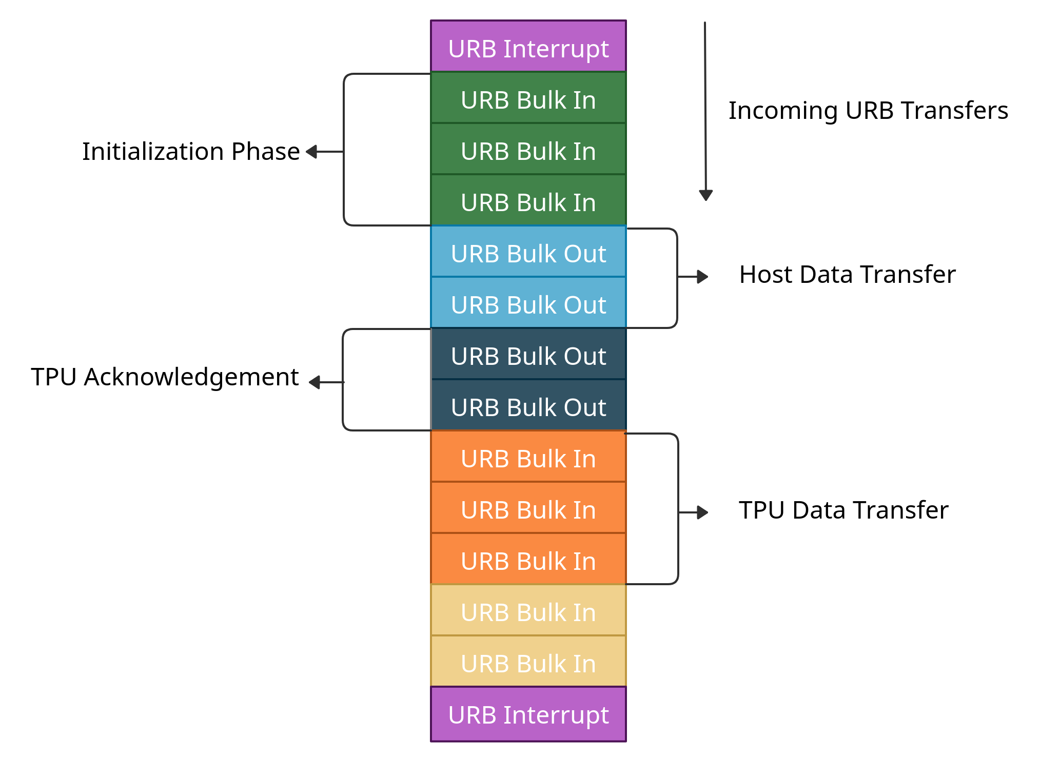
Background - USB Transactions
Wireshark
Captures transfers
Deployment
Interpreter Object
Delegates
D. Duclos-Cavalcanti
Notes:
‹#›

Slide 31
Implementation - USB Packet Analysis
USB Analysis
Input
Model Deployment
Parallel Execution N times
Pyshark
Parallel =
Start
Start
False
while True
while i < N
Filter
True
Deploy
++i
Read Packet
Final Packet?
No
Yes (Break)
End
D. Duclos-Cavalcanti
Notes:
‹#›

Slide 32
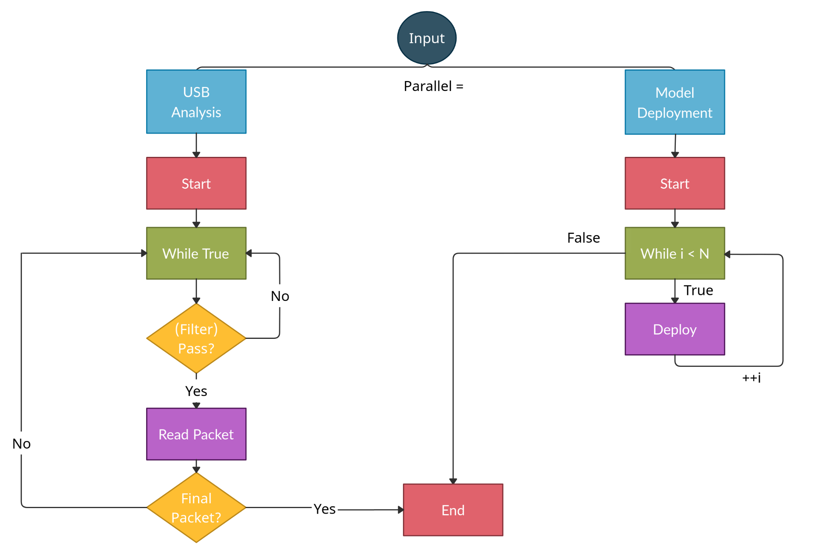
Implementation - USB Packet Analysis
Parallel Execution N times
Pyshark
D. Duclos-Cavalcanti
Notes:
‹#›

Slide 33
Implementation - Test Parameters
Different Models:
MNIST
MNIST Layers
Mobilenet
Mapped Mobilenet
Data Size - Complexity
input
input
input
input
Conv2D
Conv2D
Conv2D
MaxPool2D
Depthwise
Conv2D
Custom Edge Operation
Output
Reshape
...
FullyConnected
AveragePool2D
AveragePool2D
FullyConnected
Relu
Conv2D
Conv2D
Softmax
Softmax
Softmax
output
output
output
Conv2D Layer
MNIST Model
Mobilenet
Mapped Mobilenet
D. Duclos-Cavalcanti
Notes:
‹#›

Slide 34
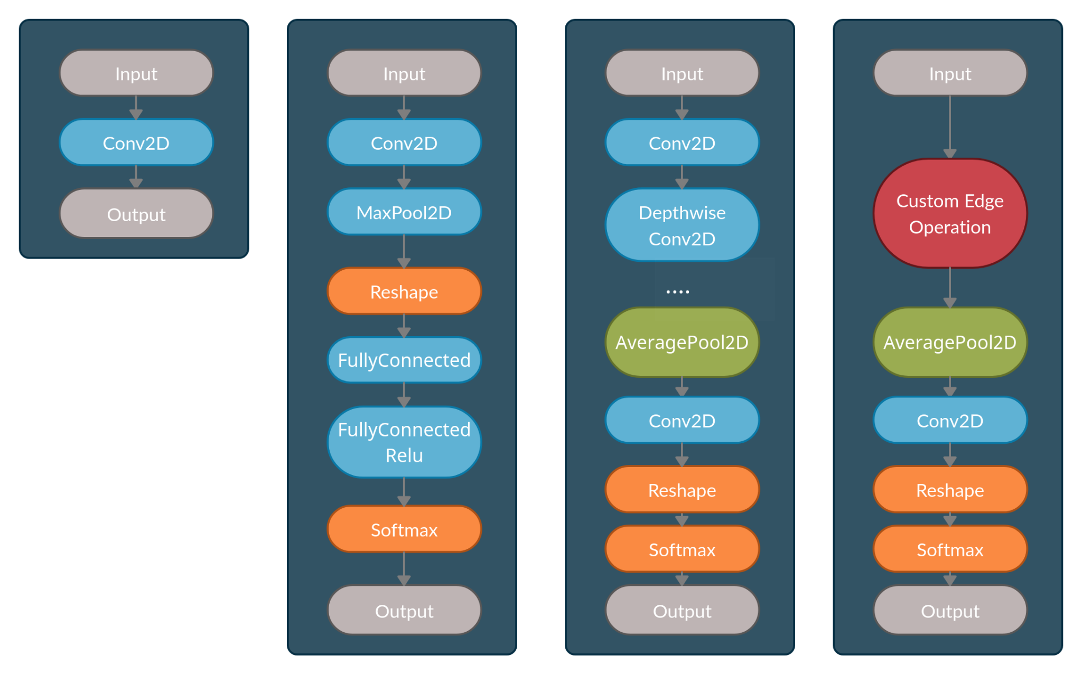
Implementation - Test Parameters
Different Models:
MNIST Layers
MNIST
Mobilenet
Mapped Mobilenet
Data Size - Complexity
Conv2D Layer
D. Duclos-Cavalcanti
MNIST
Mobilenet
Mobilenet Mapped
Notes:
‹#›

Slide 35
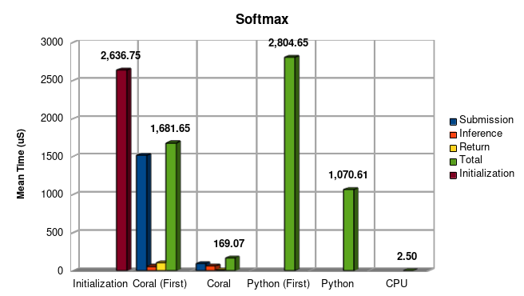
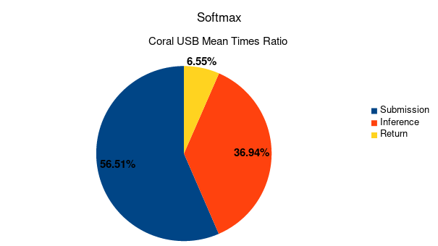
Results - Softmax Layer
Significant submission average within ratio
Expressive difference in Python and USB Total times - 15.8%
D. Duclos-Cavalcanti
Notes:
‹#›

Slide 36
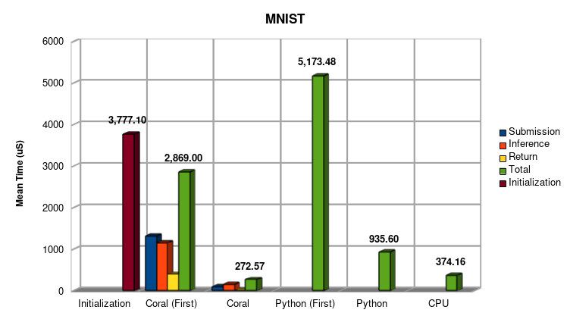
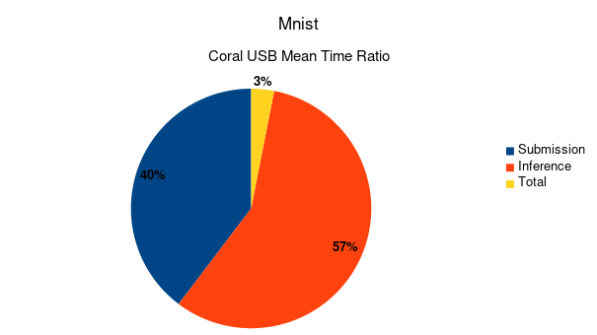
Results - MNIST Model
Inference Ratio increases
Less of a deviation between USB and Python total times - 29.1%
D. Duclos-Cavalcanti
Notes:
‹#›

Slide 37
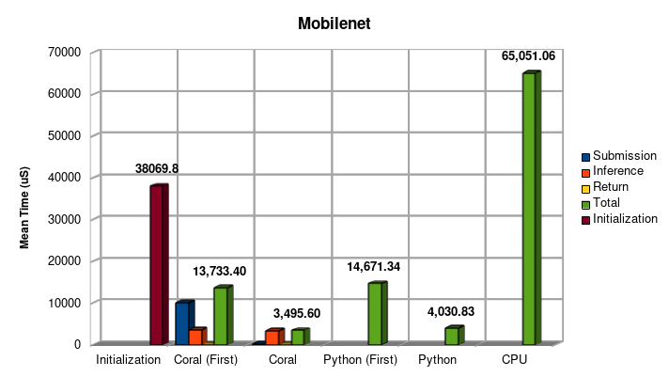
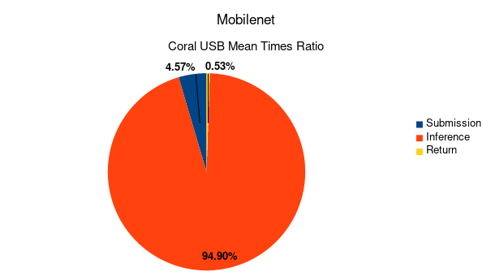
Results - Mobilenet Model
Drastic increase in Inference Ratio
Python and USB total times deviate only by 13.3%
Significant difference in Submission times
D. Duclos-Cavalcanti
Notes:
‹#›

Slide 38
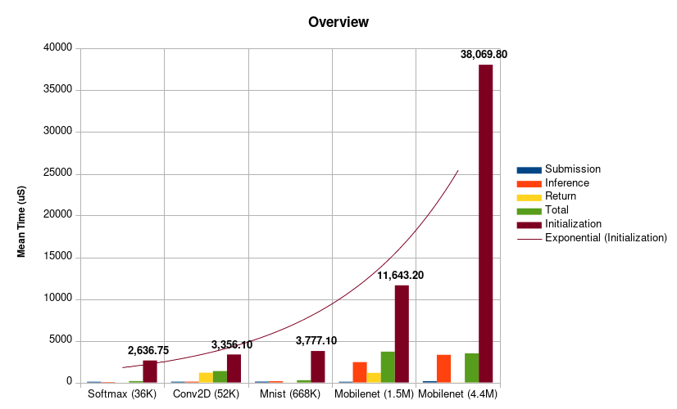
Results - Overview
Non-linear increase in Initialization Phase
D. Duclos-Cavalcanti
Notes:
‹#›

Slide 39
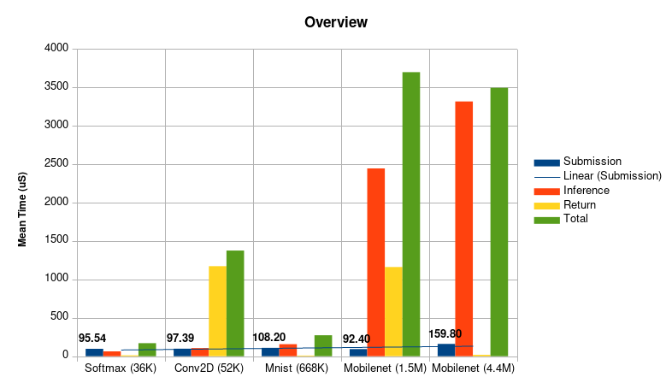
Results - Overview
Linear increase in Submission time
D. Duclos-Cavalcanti
Notes:
‹#›

Slide 40
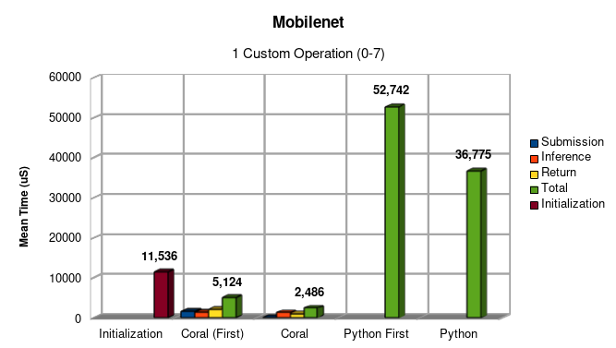
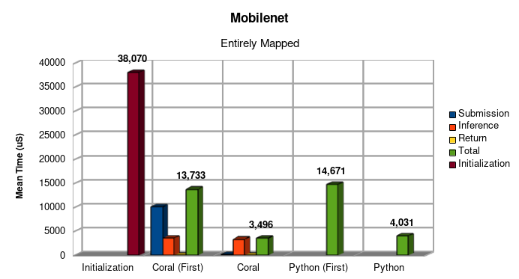
Results - Mapped Mobilenet Model
More operations mapped to coral edge => faster performance
D. Duclos-Cavalcanti
Notes:
‹#›

Slide 41
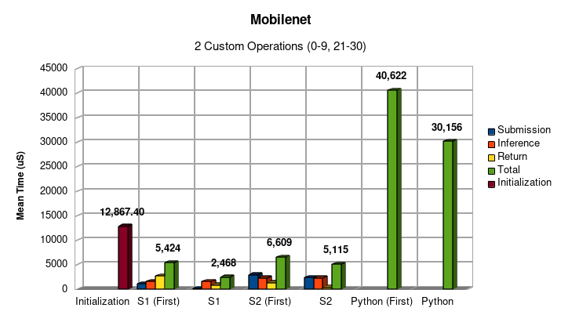
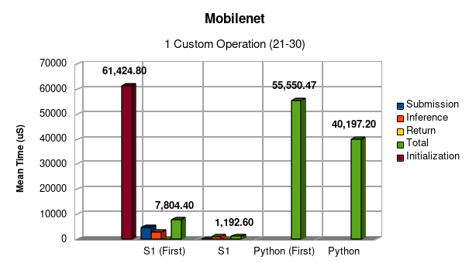
Results - Mapped Mobilenet Model
Subsequent Operations show slower deployment.
D. Duclos-Cavalcanti
Notes:
‹#›

Slide 42
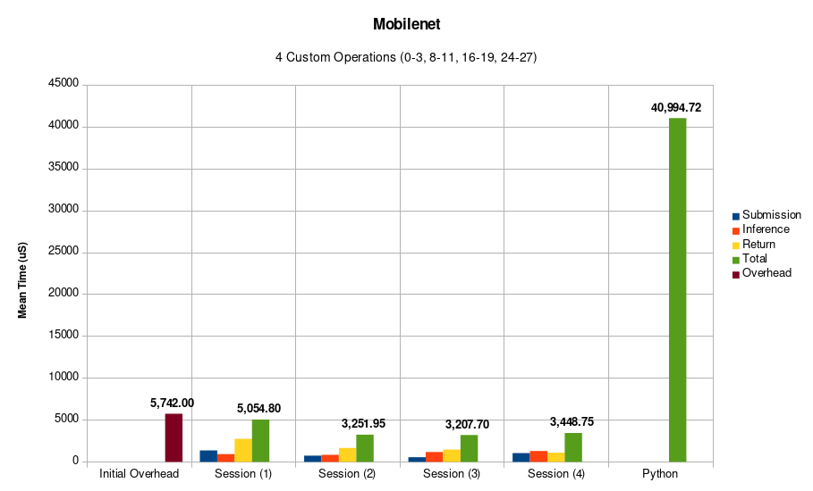
Results - Mapped Mobilenet Model
D. Duclos-Cavalcanti
Notes:
‹#›

Slide 43
Conclusions and Future Work
Conclusions:
Single layer/less complex models show a larger deviation of total deployment time.
More Complex models show a significantly smaller deviation of total deployment time.
Submission times of data are proven to be linear with an increase in model complexity.
Initialization phase occurs once and has a non-linear growth with an increase in model complexity.
Subsequent mapped operations perform slower.
Future Work
Test larger spectrum of Models with a more granular difference in complexity and larger number of mappings.
D. Duclos-Cavalcanti
Notes:
‹#›

Slide 44
Questions
D. Duclos-Cavalcanti
Notes:
‹#›

